Slide 1

Rental price analysis in Amsterdam
Ayeesha

Slide 2
Problem Statement
Amsterdam’s Real Estate Market is experiencing an incredible resurgence, with property prices soaring by double-digits on an yearly basis since 2013. Along with the property prices rental prices are also skyrocketing. As a data analyst, I want to analyse the historical housing rental data of Amsterdam and would like to get answers to the following questions

Slide 3
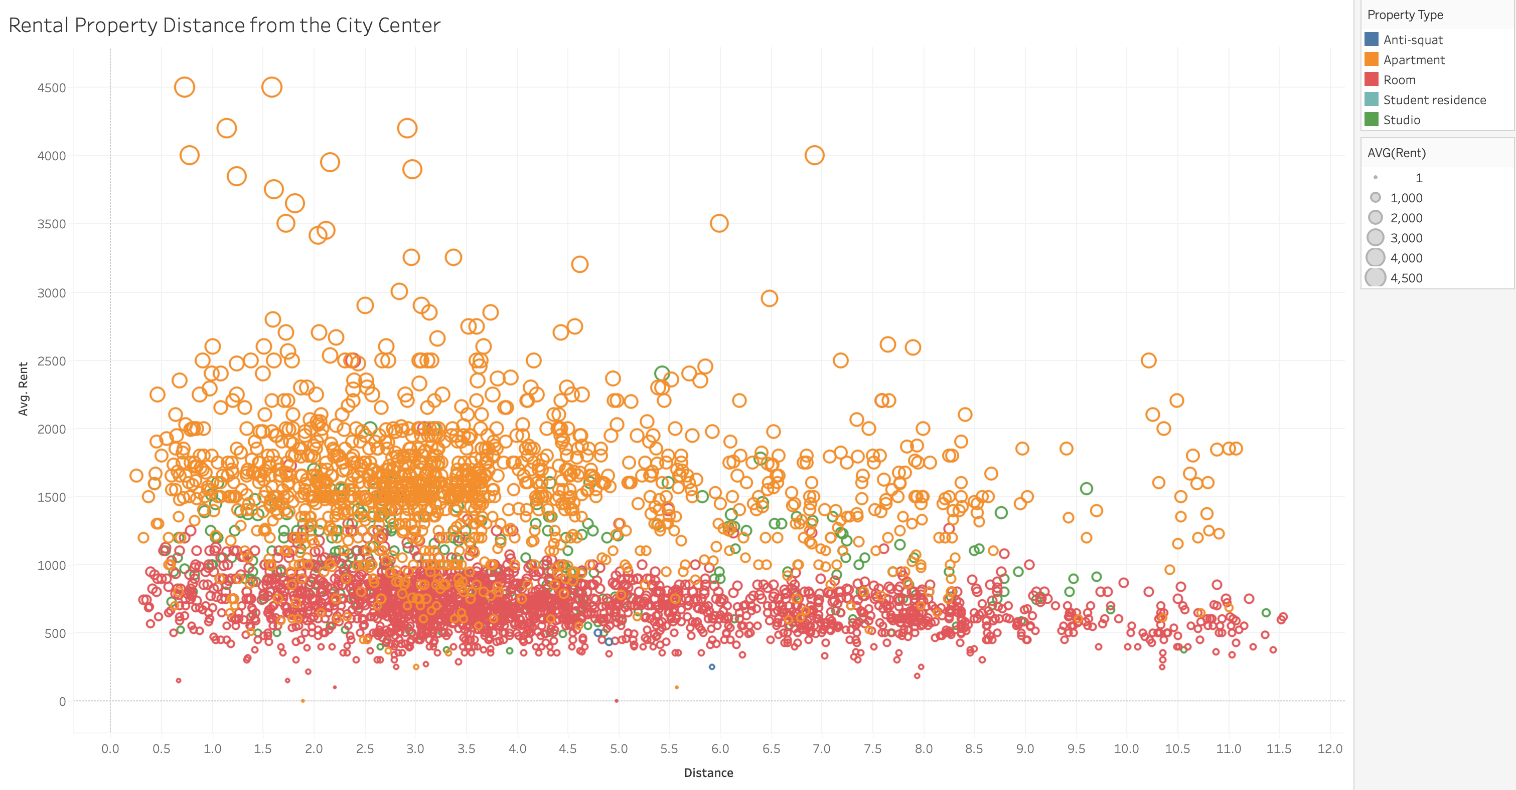
Does the houses closer to the city centre have any impact on rent?
Rent of the shared rooms are almost the same.
Apartment’s rent are quite expensive.

Slide 4
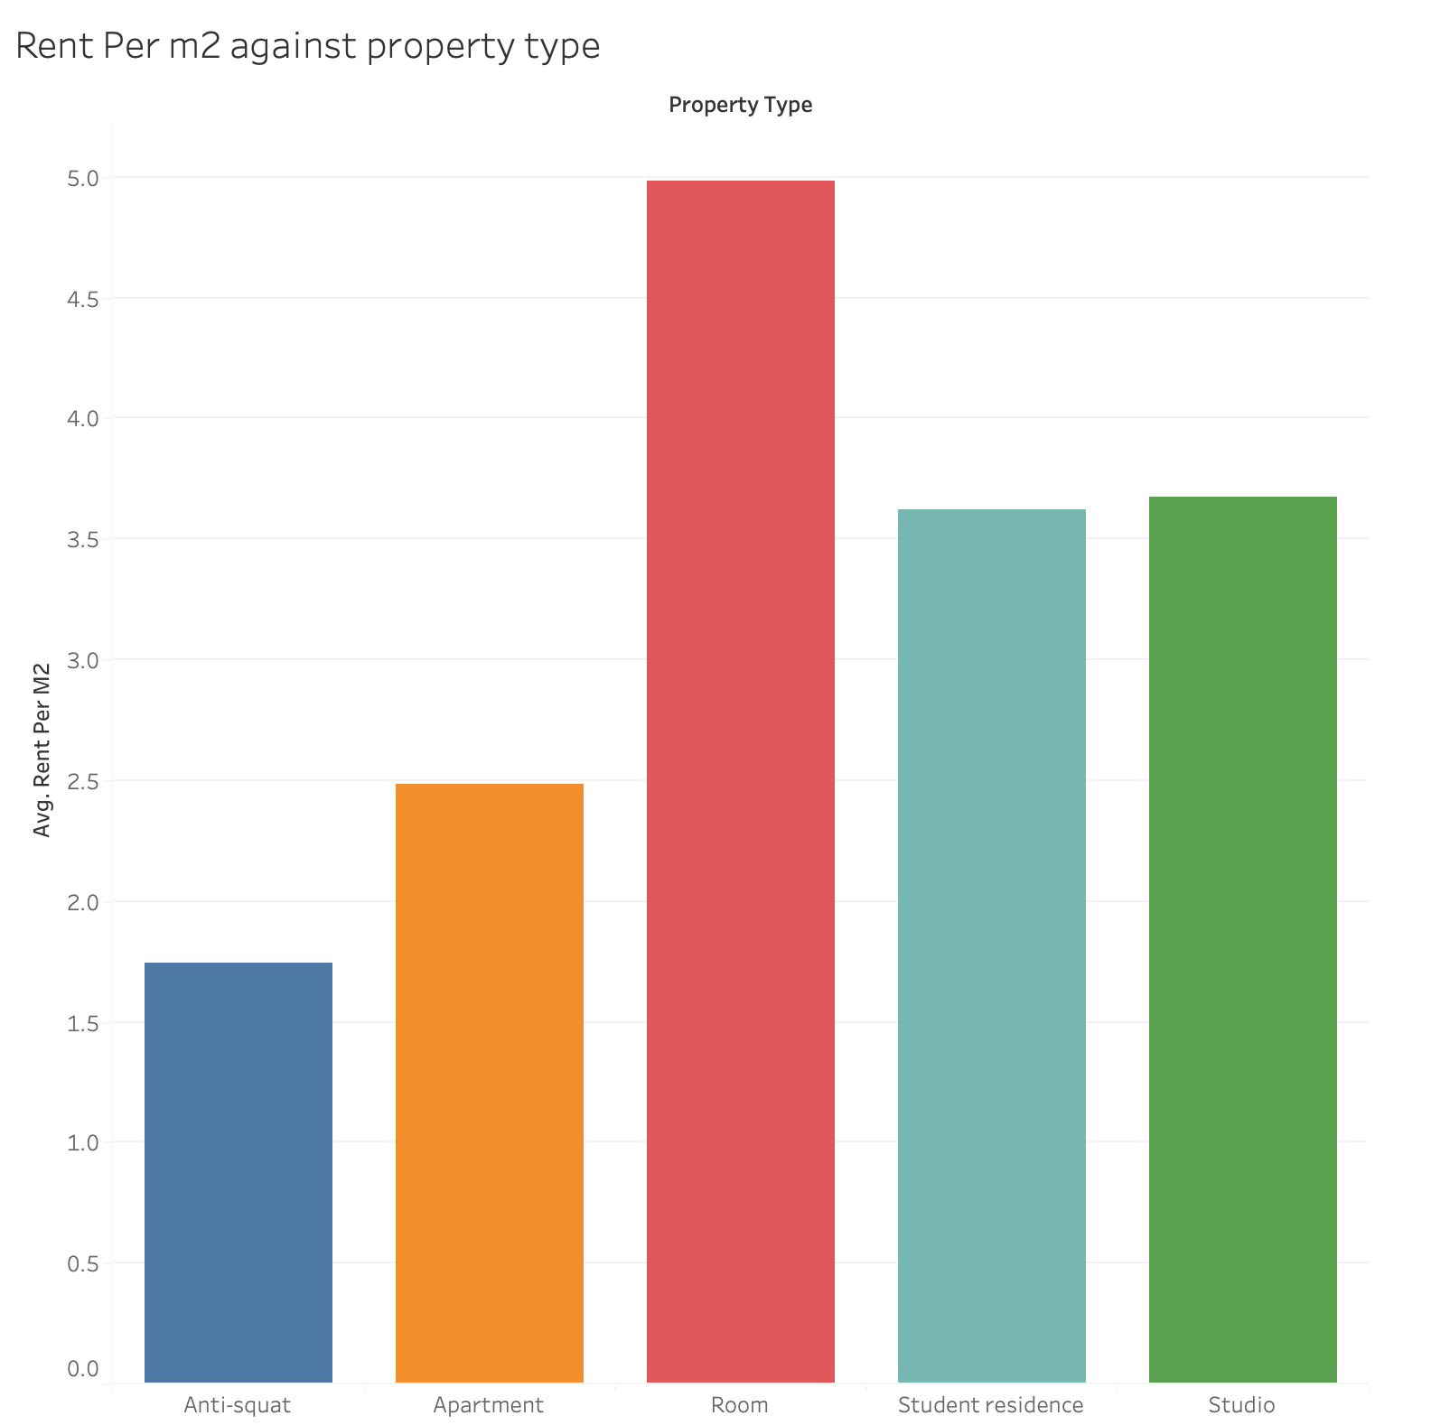
What is the impact on rent per m² with respect to the size of the house?
More demands for small houses

Slide 5
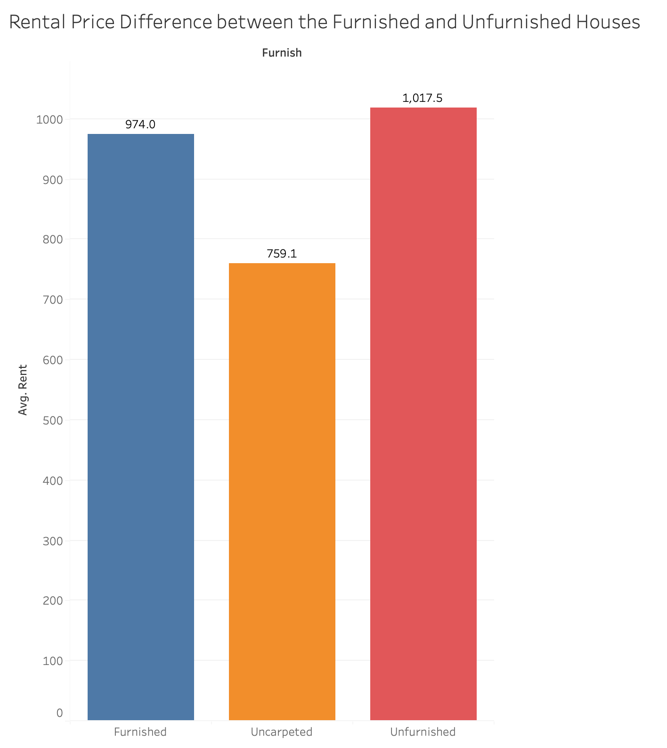
Is there any impact on rent between furnished and unfurnished houses?
There are no big difference in rent between Furnished and Unfurnished houses.

Slide 6
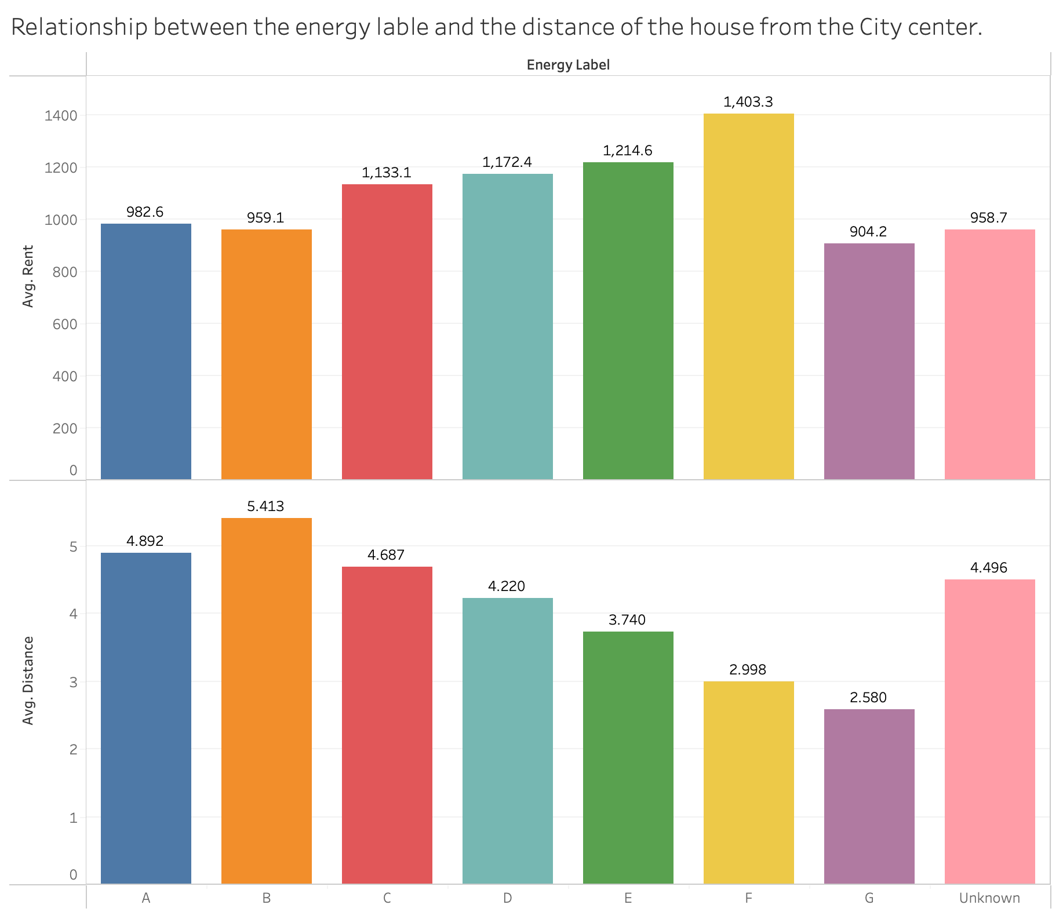
Is there any relationship between energy label, rent and distance to the city centre of houses?
Avg rent for lower energy rated houses are higher compared to the efficient energy labelled houses
Low Energy labels closer to the city.

Slide 7
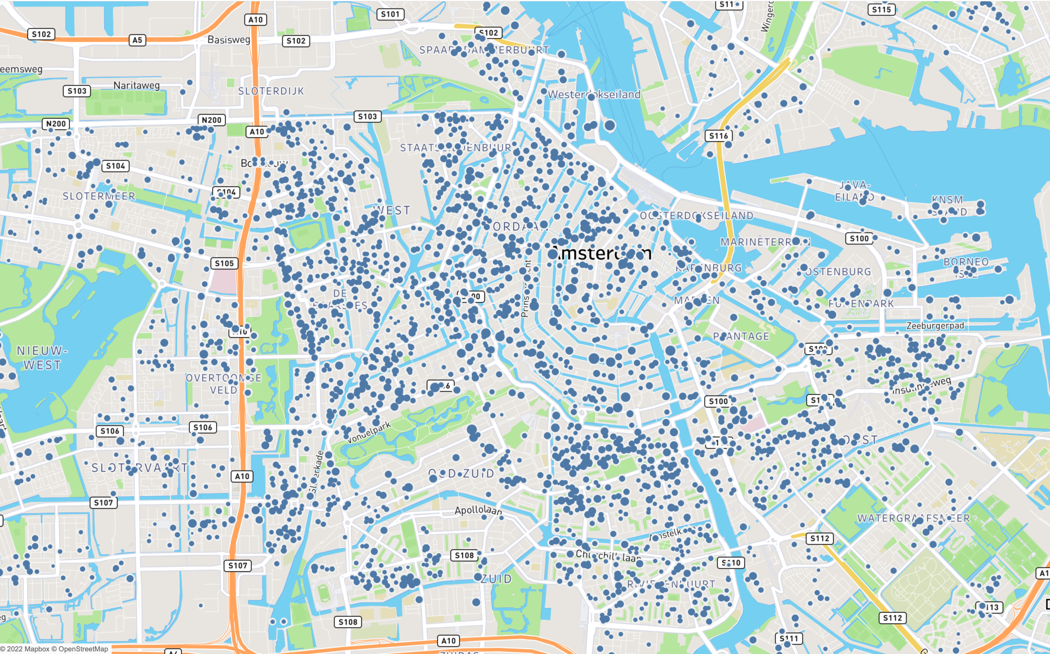
What are the hottest areas to avoid renting?
As you can see, closer to the city center, though more houses are available for rent, the average rent is comparatively higher than outside of the city

Slide 8
Conclusion
Based on the above analysis, there is a clear evidence that, the rental prices are quite high in Amsterdam, irrespective of the other factors like, size, distance and energy label, etc.,
This could be due to the supply and demand factors

